Slide 1
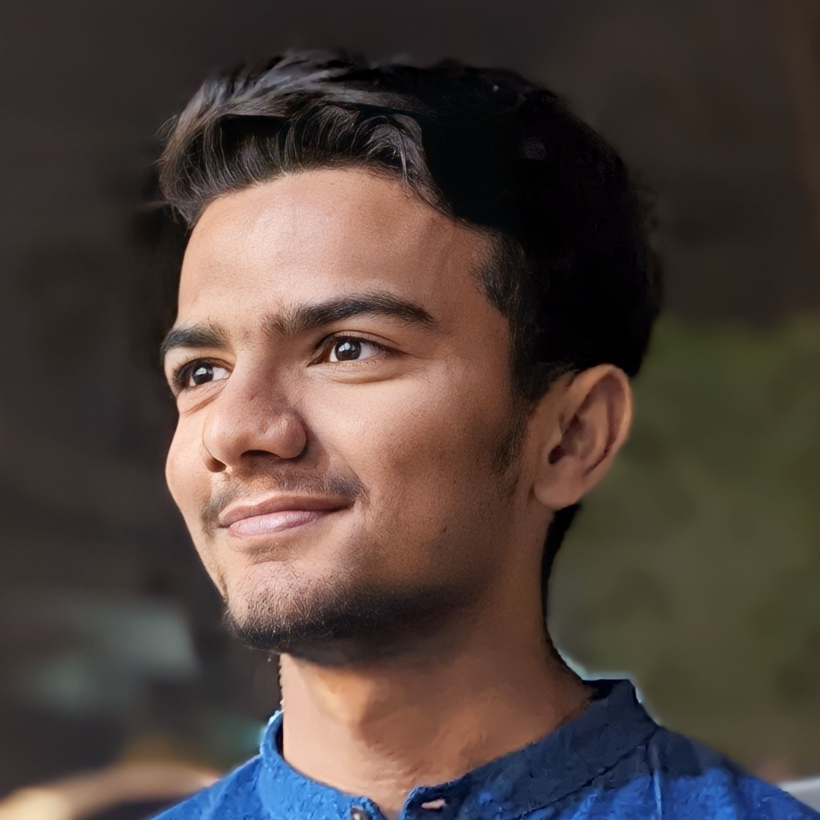
Muhammad Mufeez
Student at FAST University 📚 | Passionate about creating captivating content 🌟

Slide 2
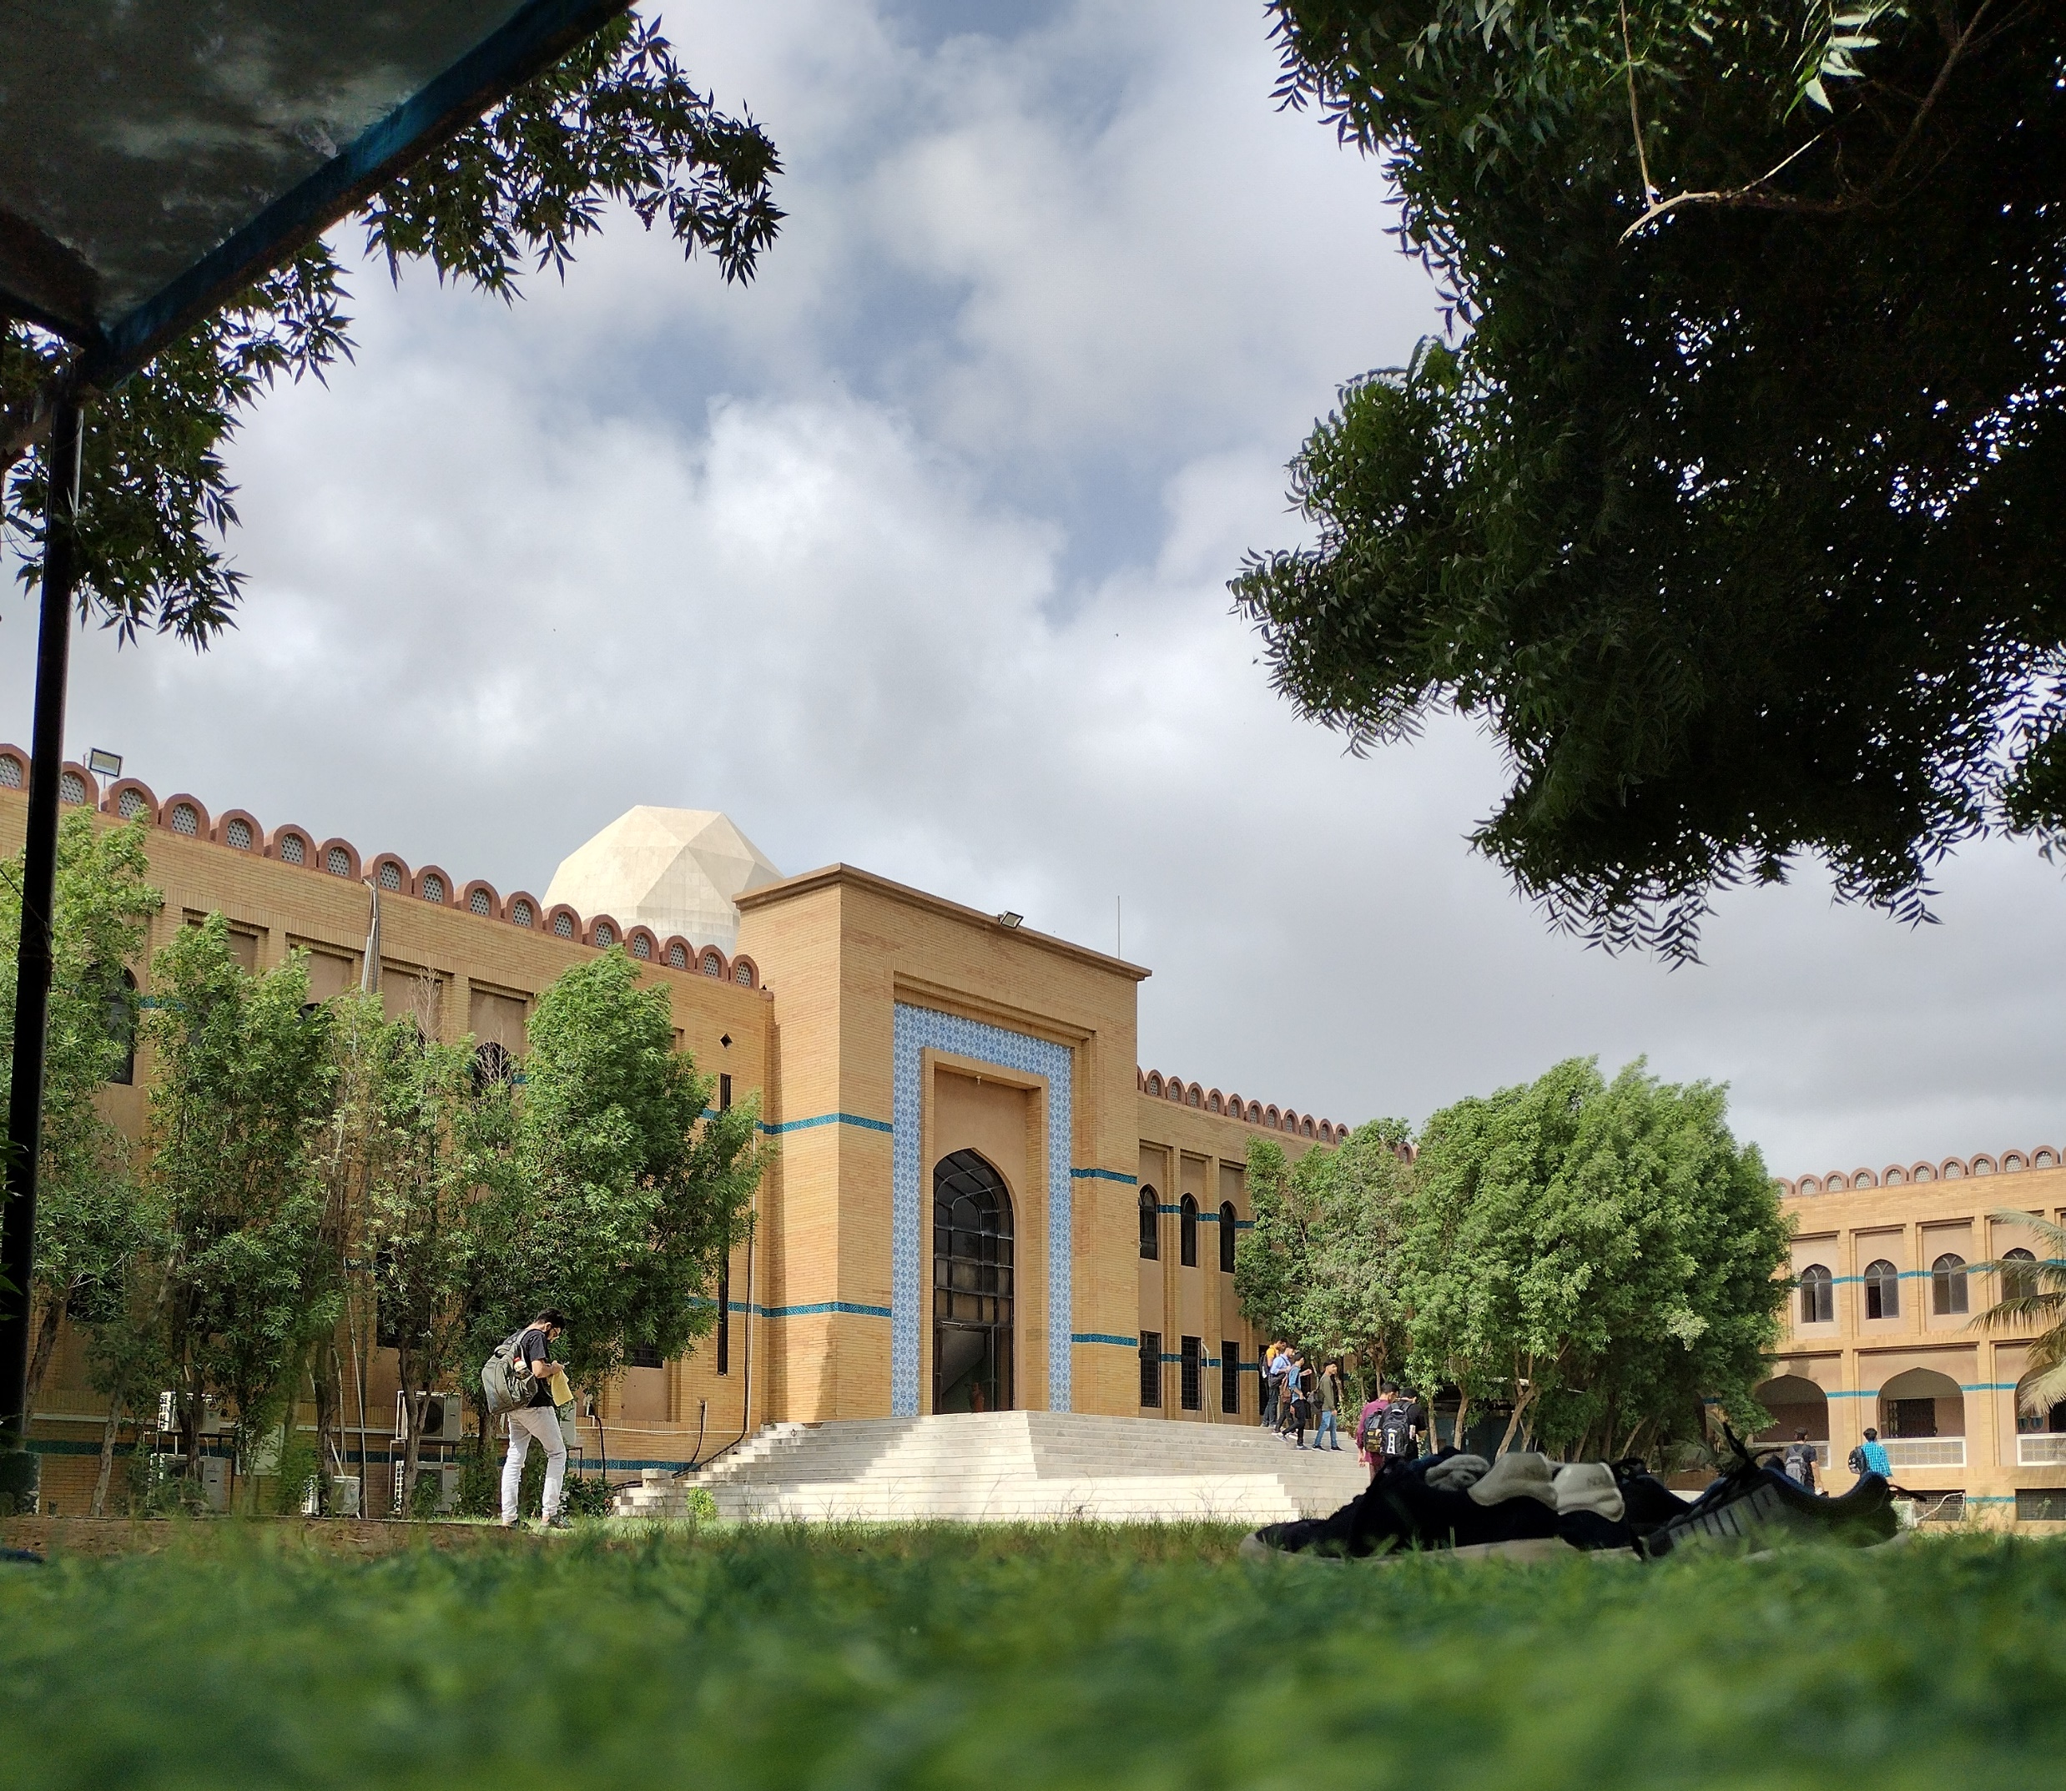
About
Phone
+92 318 2993401
Mail
Mufeez.hanif123@gmail.com
Location
Karachi, Pakistan
Age
19
Education
2023 - present
Bachelors of Science In Computer Science
FAST National University Karachi
2021 - 2023
Intermediate
Government Dehli College Hussain Abad Karachi
2019 - 2021
Matriculation
Memon Boys Secondary School

Slide 3





Hobbies
After getting admitted into Fast nuces, I do not have time for my hobbies but sharing them ☺
Cricket
Football
Read Books

Slide 4

Semester Goals
TO learn the basics of how to build algorithms
How to do critical thinking
Get 4 GPA
Build Networks, as Network are Net worth

Slide 5
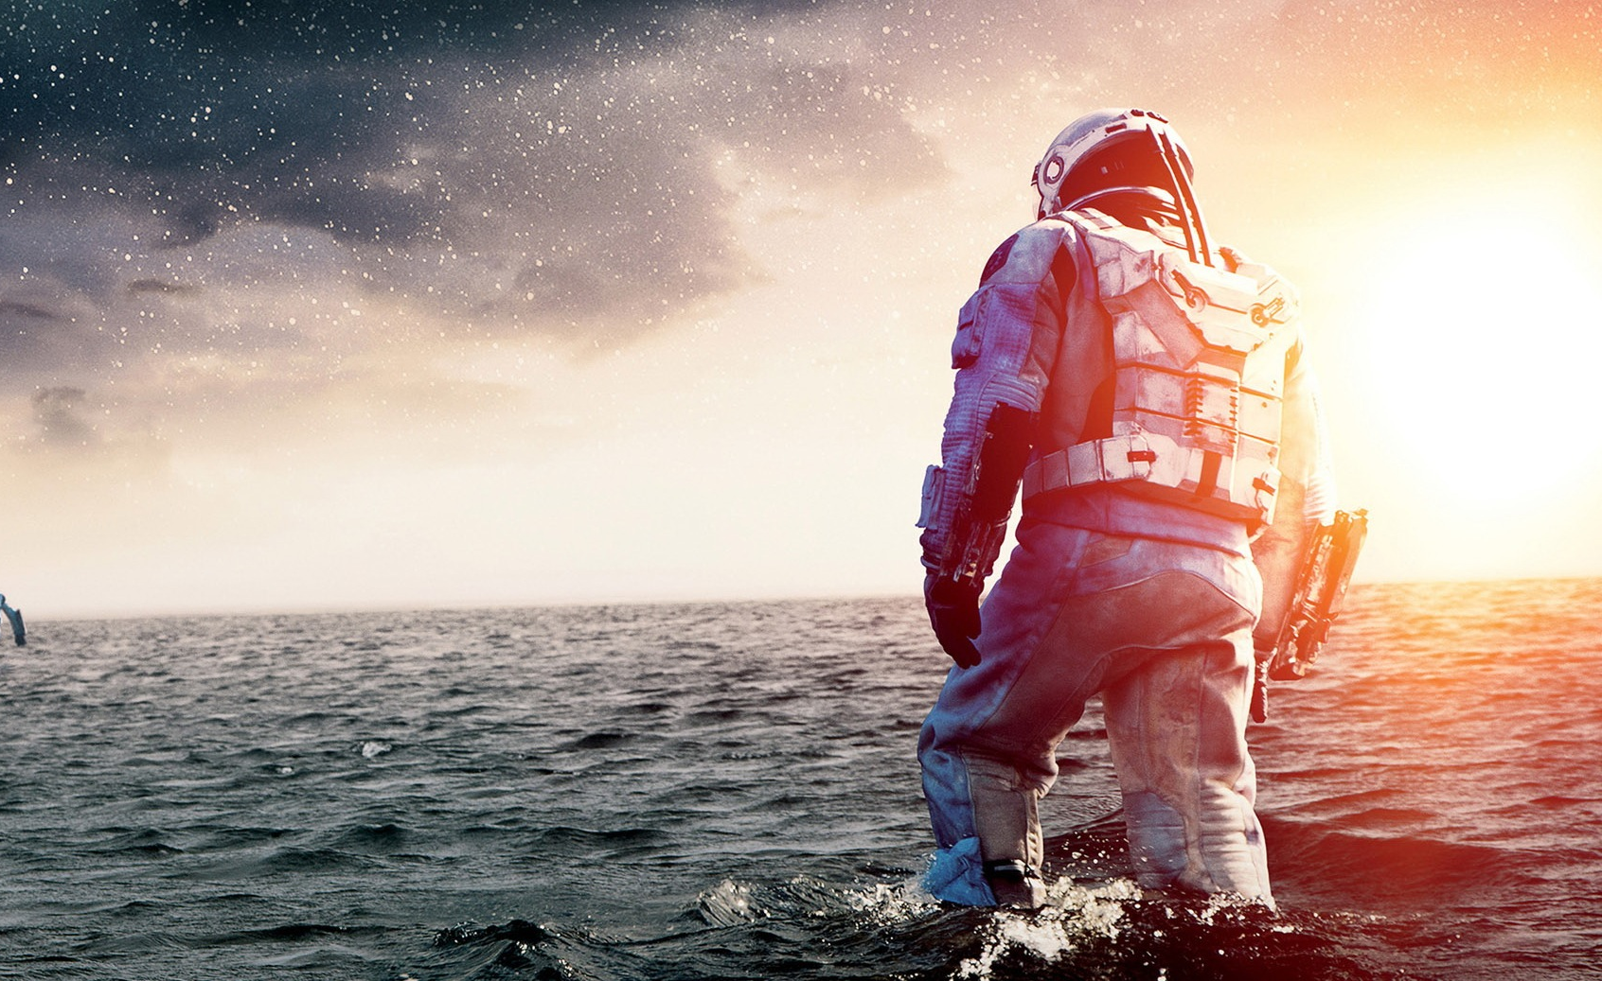
Favorite Movie
Interstellar
I love Interstellar because it combines mind-bending science fiction with heartfelt human drama. The film's stunning visuals and scientific accuracy captivate me, while its exploration of love, sacrifice, and the unknown inspires deep emotional connections. Interstellar's intricate plot, brilliant performances, and thought-provoking themes make it a cinematic masterpiece that continues to resonate with me.

Slide 6





“
“
Thank You!
Karachi
Mufeez.hanif123@gmail.com
+92 3182993401
www.something.com

